Slide 1
Meridian Laboratory Corporation
Inside & Out
Training Development Program
Updated 11/2022 IH/MS
Notes:
India: Remember to update date after each revision of content.

Slide 2
A Review of Medical Errors in Laboratory Diagnostics and Where We Are Today. –Julie A. Hammerling ASCP Lab Medicine Feb 2012
Sources of Laboratory Error
Most errors occur in the pre- and post-analytical phases.

Slide 3
Pre-Analytical
Phase of Testing

Slide 4
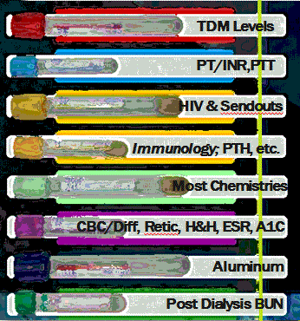
for Specimen Collection
Blood Cultures should be collected before any other specimen.

Slide 5
Lavender Top Specimens
Light Lavender
Dark Lavender
2mL Sample
“Pediatric” Draw
4mL Sample
Standard Draw
Fill Line
Performs the same tests.
Fill Line

Slide 6
Labeling Specimens
Using MLC Barcode Labels
Incorrect Labeling
Correct Labeling
The barcode of the label should be closest to the tube stopper.

Slide 7
Labeling Specimens
Handwritten Labels
Incorrect Labeling
Correct Labeling
Patients First, Last Name
Date of Birth
Facility Name
Collection Date
The name of the patient should be closest to the tube stopper.

Slide 8
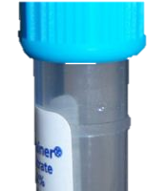
Specimen Integrity is…..
ensuring each step of collection, handling, and transportation meet
the requirements for the test being ordered.
1)
2)
Choosing the correct
container for collection.
3)
Centrifuging
4)
Meeting the FILL requirements.
Storage Temperature:
Room Temp
Refrigerated
Frozen:
Inverting all tubes to prevent clotting.

Slide 9
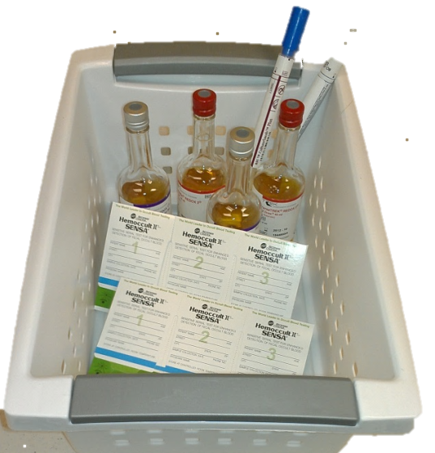
Storage Temperatures
Room Temp.
Refrigerated
Frozen
Blood Samples
Urine Samples
Doe, John 3/23/1945
Freeze Plasma from transfer tube.
Blood Cultures
Occult Cards
Wounds Cultures
PTT

Slide 10
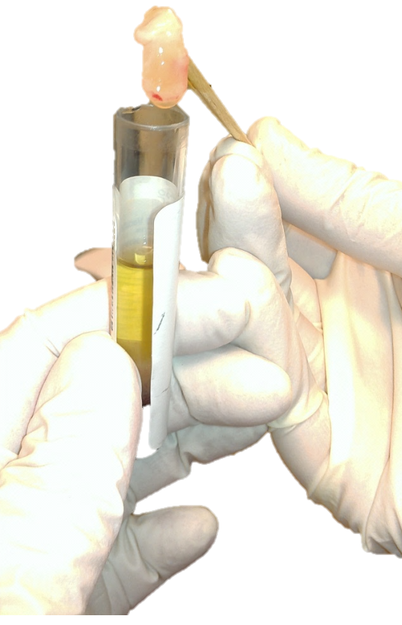
Specimen REJECTIONS…..
occur when the integrity of the sample is compromised.
Pre Bun = Post BUN
Hemolysis
Heparin Contamination
Top Rejected Incidents
Quantity Not Sufficient
Clotted
Unspun
Specimens are much easier to Run than Reject.
Fibrin Clot: Caused by inadequate clotting time before centrifuging.

Slide 11
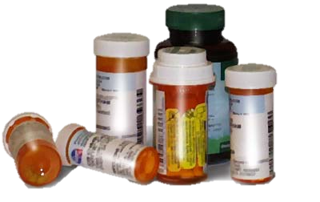
Hemolysis
Pre BUN = Post BUN
Interfering Medications
Hemolyzed Serum
Collection Error:
Collected both Pre BUN and Post BUN specimens at the same time.
Trending Results:
Increases:
Calcium
Iron
Potassium
Albumin
LDH
Phosphorus
If results of entire patient population are shifted higher or lower, consider any new administered medications, and notify the lab.
Labeling Error:
Labeled the Pre BUN with Post BUN label, or vis versa.
Decreases:
Bilirubin
T4
Glucose
Specimen REJECTIONS…..Continued.

Slide 12
Sample Handling for I-PTH
Clotting time: Minimum of 10 minutes before centrifuging.
Centrifuge for 10 minutes at 3500 RPMs
Refrigerate until transported.
Otherwise will falsely decrease results.
Do NOT let sample sit unspun for longer than ½ hour.

Slide 13
Therapeutic Drug Monitoring
Collection Times
TDM
Dilantin
(Phenytoin)
Digoxin
(Lanoxin)
Vancomycin
Valproic Acid
(Depakote)
Peak- 30 minutes after drug infusion.
Trough- 30 minutes before drug infusion.

Slide 14
Blood Culture Specimen Collection
Store bottles at room temperature, protect from light.
Site Preparation
Bottle Preparation
Bottle Inoculation
Scrub site with 10% povidone iodine then with alcohol.
Disinfect the bottle stopper with 70% isopropyl alcohol .
Allow to dry for 1 min.
Puncture first the Aerobic then Anaerobic.
Do NOT overfill the bottle.
Minimum Volume = .5ml per bottle.
Max.
Min.
Follow the above steps and PREVENT contamination.
It’s likely specimens that grow Staph Epi were improperly collected.

Slide 15
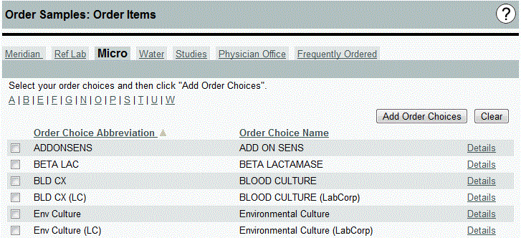
Blood Culture Ordering Procedure
One sample ID number
One set of collected blood culture bottles
One draw site (left/right arm; arterial/venous)
One collection time.
Each order should represent the following:
The number of blood culture sets should equal the number of orders placed per patient. Ex Two sets=Two orders.

Slide 16
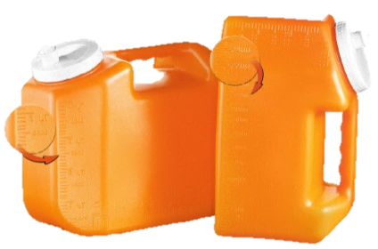
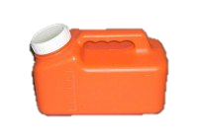
24 Hour Urine Collection
Patient Instructions
Specimen Handling
Patient should not urinate directly into the collection bottle if a acid preservative exists.
•Mix the urine jug by inverting several times.
•Note the Total Volume on the outside of the jug.
•Record the Total Volume on the Barcode label.
•Pour a well mixed sample into a labeled red top.
•Start collection in the A.M (Do not save the 1st urine).
•Note the start time.
•Store all further urine samples for the 24 hours.
•The last sample collected should be close to the start time.
•Store urine in the refrigerator.
Labeled Specimen
Doe, John 3/15/1936
Total Volume: 286 cc

Slide 17
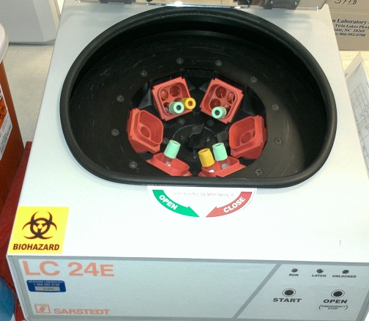
Centrifuging Specimens
ALL Gold and Green Top tubes should be centrifuged before being sent to the lab.
Centrifuge Information
Preset RPM at 3500
Hold Specimens for minimum of 10 min. before centrifuging.
Specimens spin for 10 min.
Tubes placement should be balanced.
Required quarterly maintenance inspections.
Signs of Unbalanced Centrifuge
Insufficiently Spun
Very Loud
Uncontrolled rocking.
Insufficiently spun tubes.
Properly Spun
Unspun
Tests with Special Instructions that require centrifuging should be processed accordingly.

Slide 18
Specimen Types
Serum
Plasma
Whole Blood
Serum Specimens = No Additive
Plasma Specimens = Additive

Slide 19
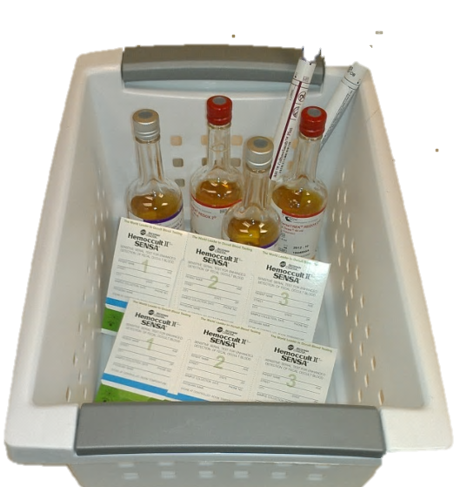
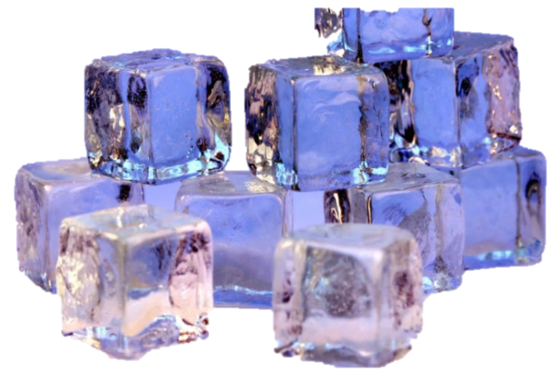
MLC Courier Services
Specimens for pickup should be organized according to the storage requirements established for the tests being ordered.
Room Temp Specimens
Refrigerated
Room Temp.
Frozen

Slide 20
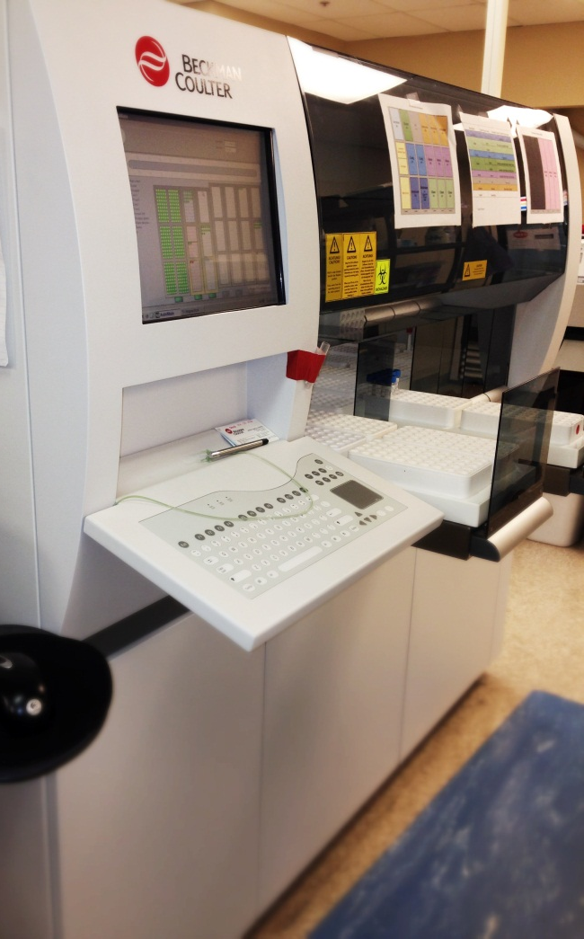
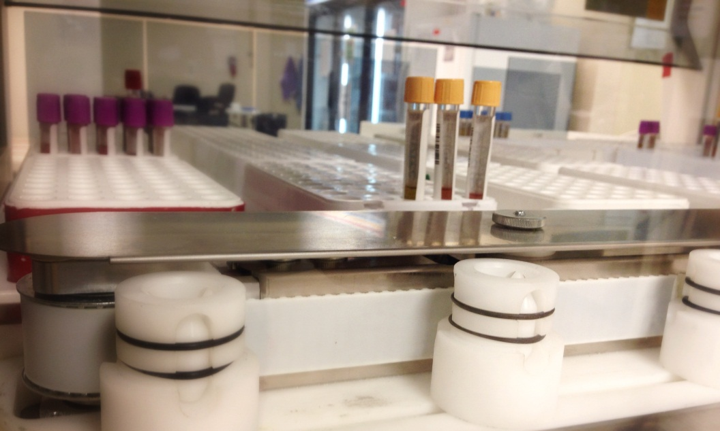
Front-End Automation
Auto receipt of patient tubes
Photographs tubes received
Auto sorts tubes into each department rack
Receives 300 tubes in 15 minutes
Improved TAT and FEWER Errors

Slide 21
Analytical
Phase of Testing

Slide 22
Delta Check
Built-in Quality Control
Coagulation Analyzer
Tech notification of any test result that doesn’t match the patients previous history.
Requires further investigation to ensure specimen integrity and correct patient identification.

Slide 23
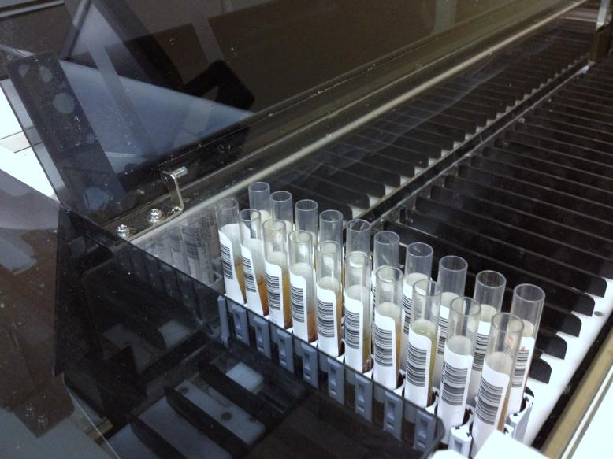
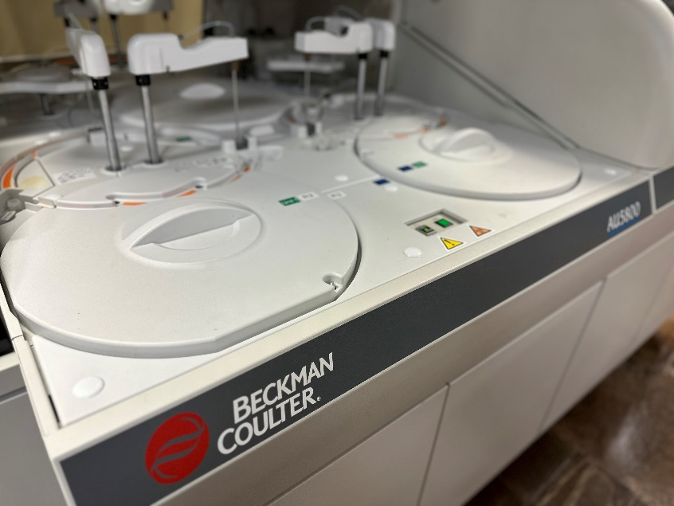
Chemistry Analyzer
Analyzer: Beckman 5800 (2)
Common Tests:
Chem Comp
Lipid
Liver

Slide 24
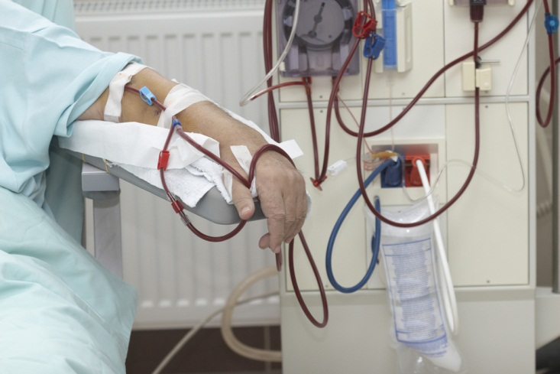
KTV Test Orders
URR Not Exact
Pre BUN/Post BUN
PD Adequacy (Watson/Watson)
Comparable to “Hume” method
KT/V Daugirdas Most Accurate
Pre BUN/Post BUN
Pre Weight/ Post Weight
Time Dialyzed
Incorporates “age” in the male calculation
Close in value to KT/V
Invalid KT/V Results will be rejected.
<0.2
> 3.5

Slide 25
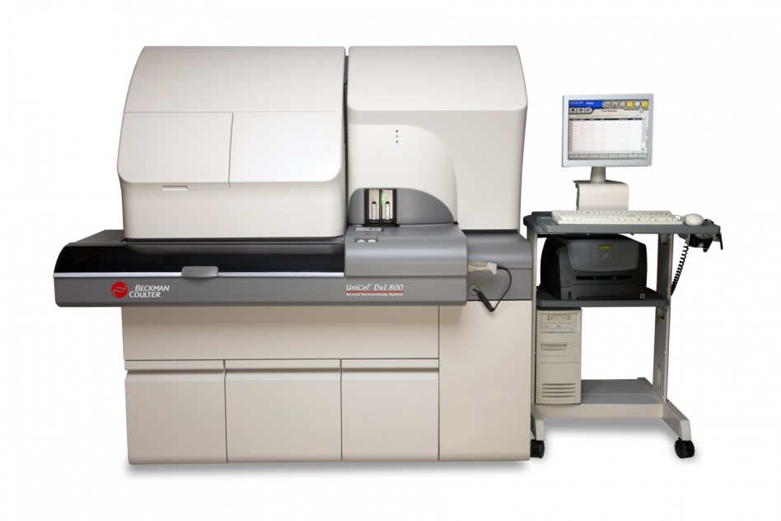
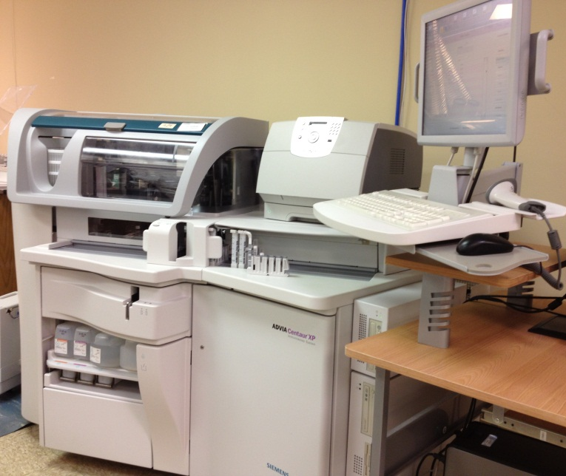
Immunochemistry Analyzers
Analyzer: Siemens Centaur
Analyzer: Beckman Coutler DXI 800
Common Tests:
i-PTH
B12
Folate
Infectious Disease (Hepatitis C, HIV, etc)

Slide 26
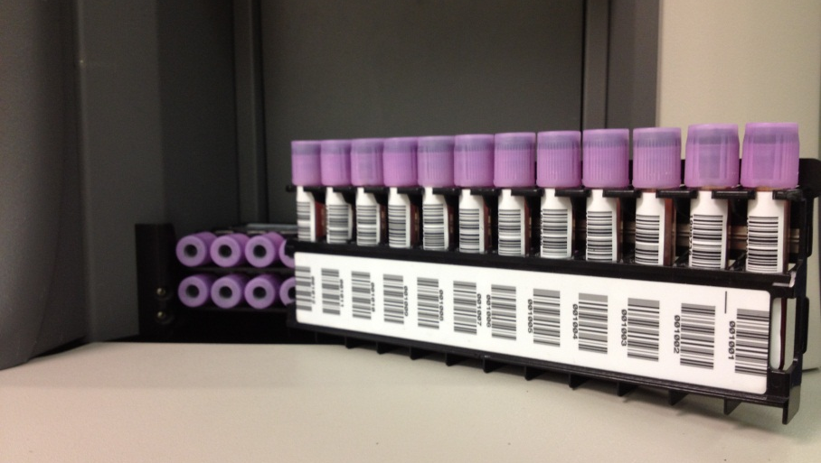
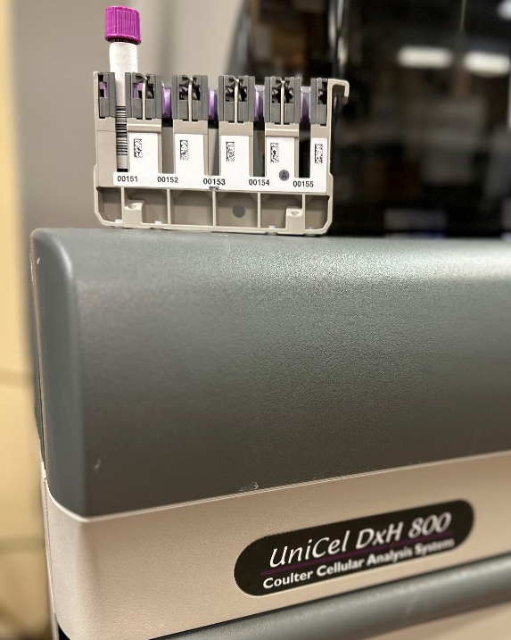
Hematology Analyzer
Analyzer: Beckman Coulter DxH (2)
Common Tests:
CBC/DIFF
HGB/HCT

Slide 27
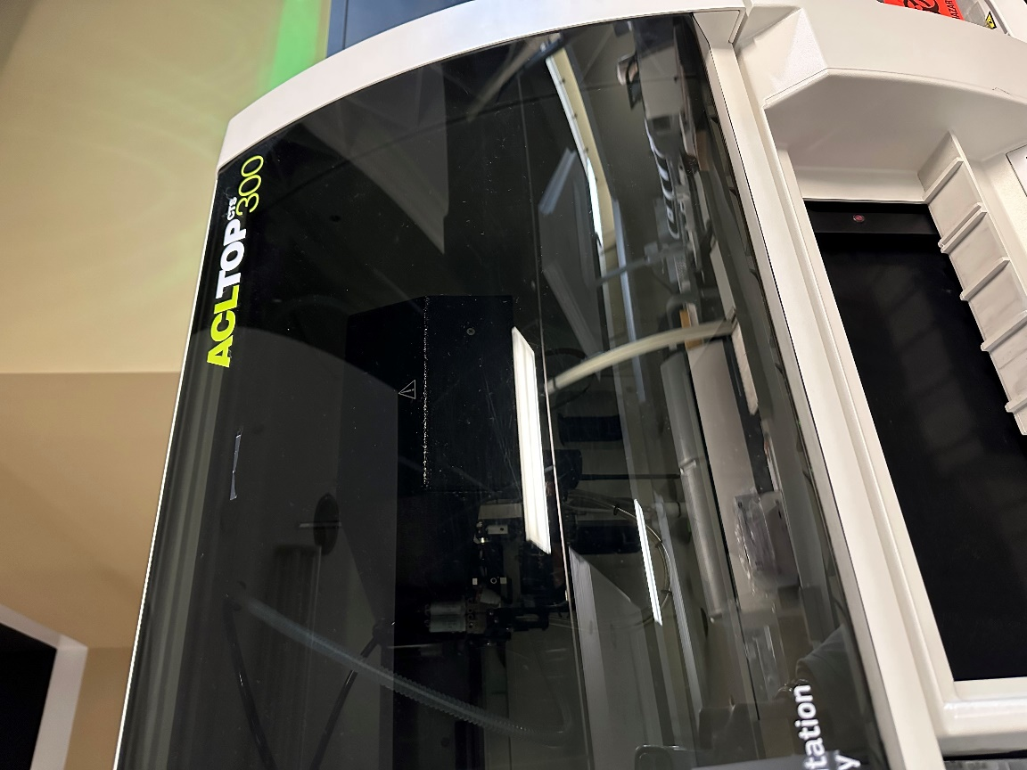
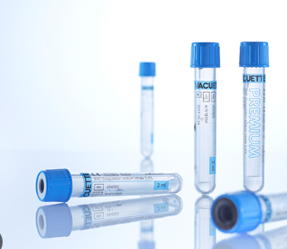
Coagulation Analyzer
Analyzer: IL Top 300
Common Test: PT/INR, D-Dimer

Slide 28
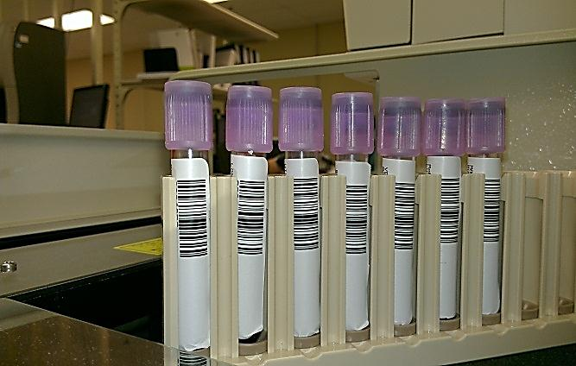
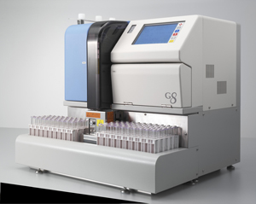
HgbA1C Analyzer
Analyzer: Tosoh G8
Test: Only HgbA1C

Slide 29
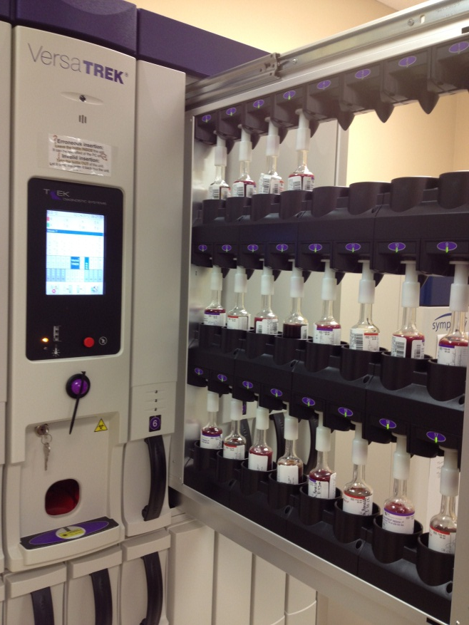
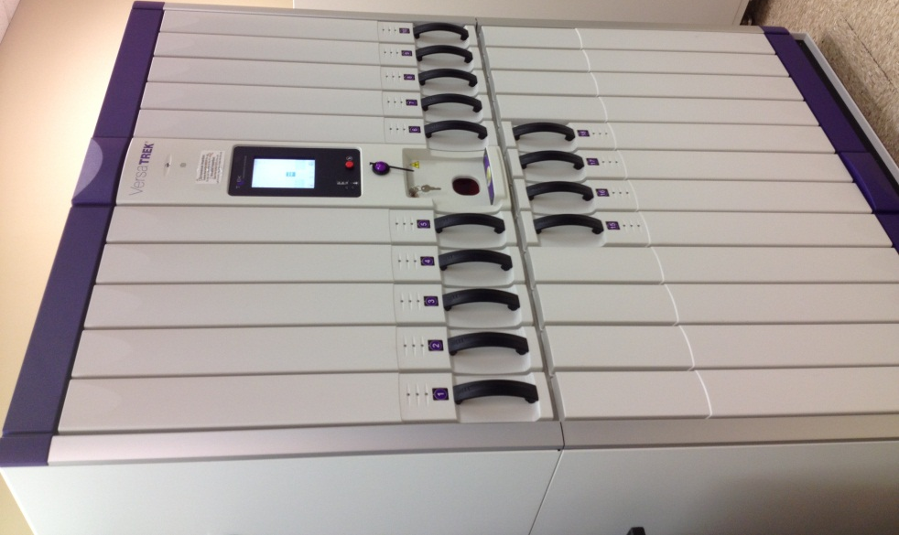
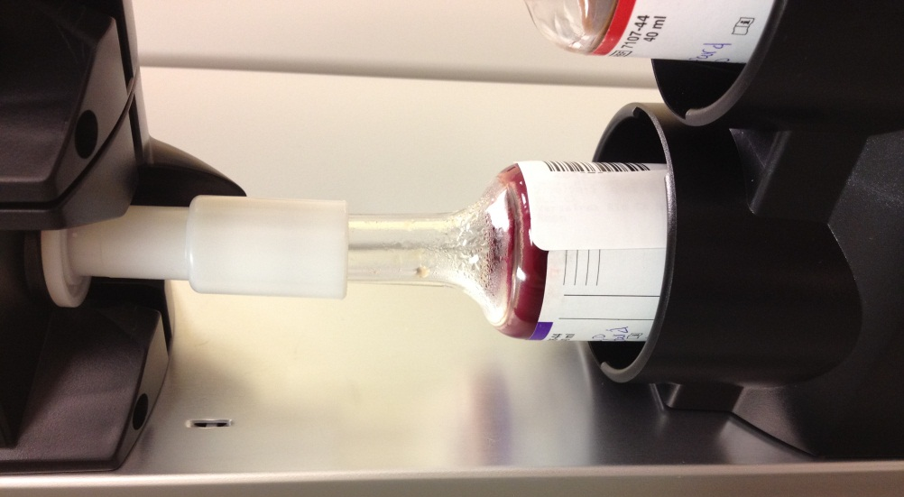
Microbiology Blood Culture Analyzer
Overfilled

Slide 30
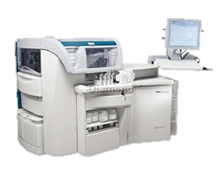
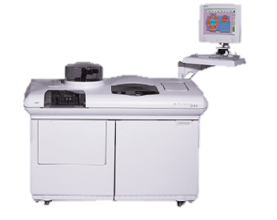
ComparingResults
can be like comparing Apples to Oranges.
Meridian Laboratory Corp.
Hospital STAT Laboratory
Results will be almost exact.
Results can be used for trending.
Reference ranges will likely be the same.
Siemens Centaur
Siemens Centaur
Meridian Laboratory Corp.
Hospital STAT Laboratory
Results might be biased either higher or lower.
Results should NOT be used for trending.
Reference ranges are often different.
Acceptable when assessing acute episodes.
Siemens Centaur
Siemens Immulite

Slide 31
Post-Analytical
Phase of Testing

Slide 32
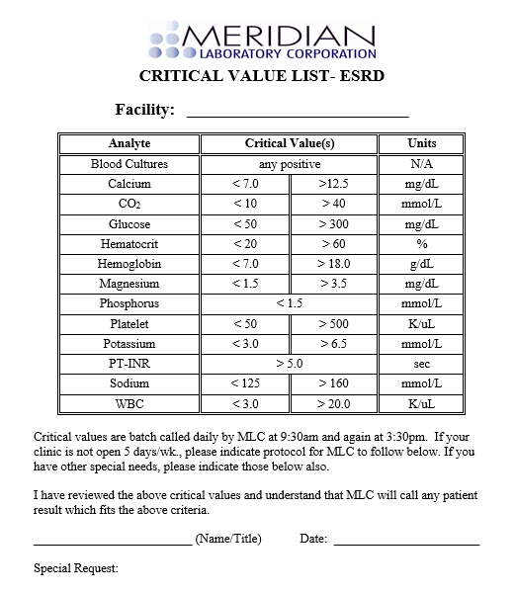
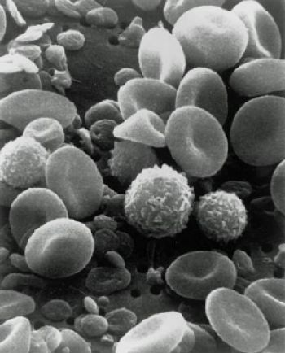
Critical Results…
are those that indicate the need for immediate treatment of a patient to prevent any potentially life threatening situations.
Criteria Established by Medical Director
Results Called in Batch
Results Called to a Charge Nurse
Read back policy

Slide 33
Forms

Slide 34
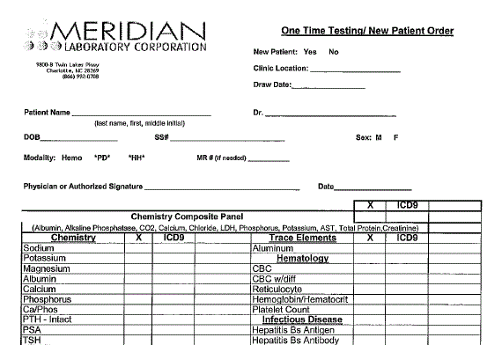
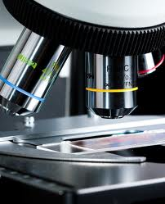
One Time Testing
Utilized for Admission Lab Tests and Add-On Testing.
Complete the top portion
Required Authorized Signature
Indicate Tests and Dx. Codes

Slide 35
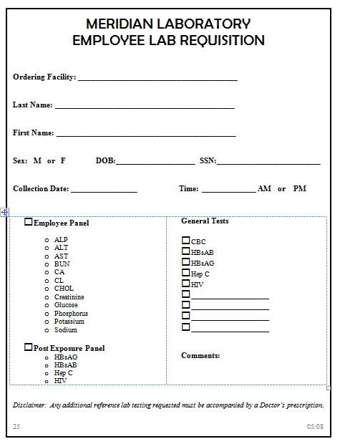
Employee Lab
Requisition
Laboratory tests for employees of our clients.

Slide 36
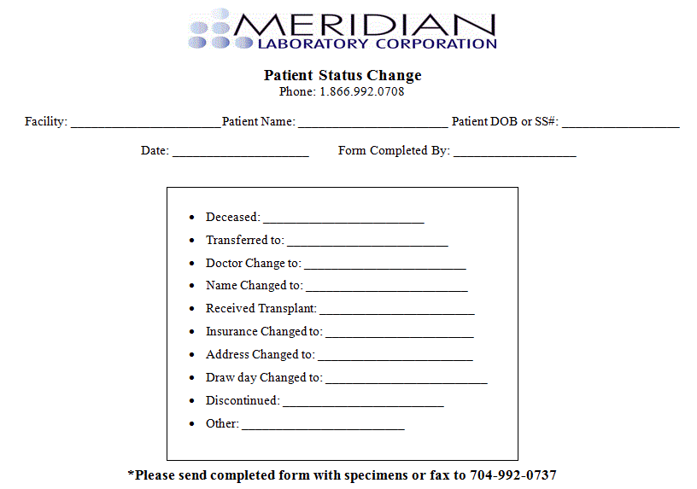
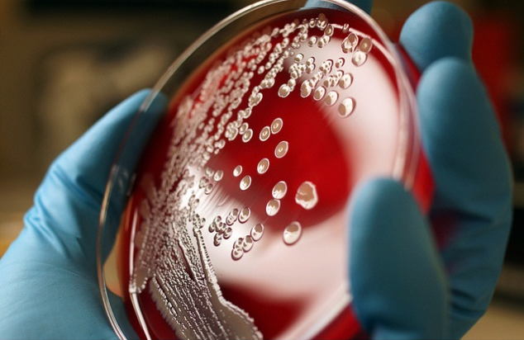
Patient Status Change
Please be sure to indicate the patients DOB and SSN.

Slide 37
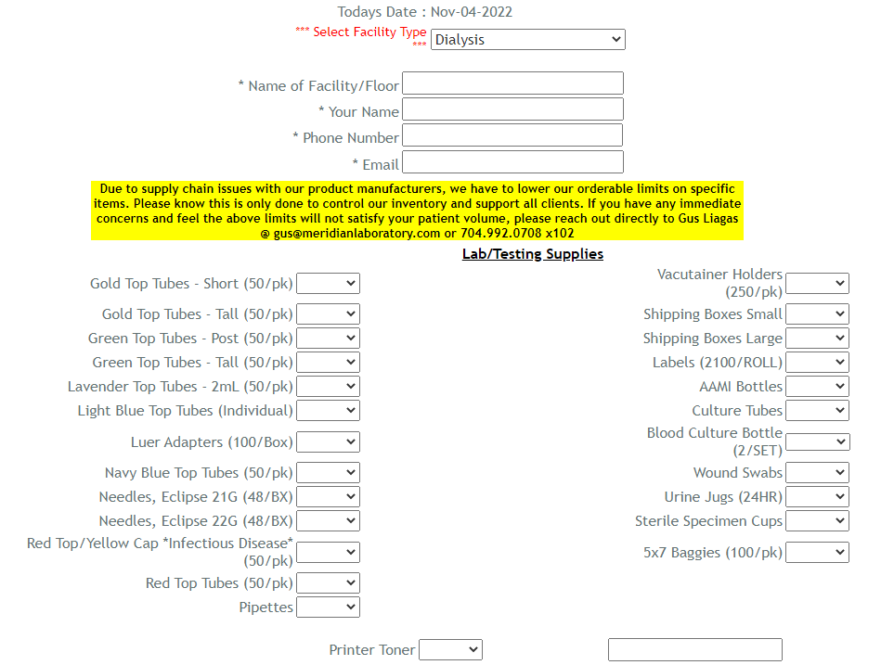
Supply Orders
Required Information
Facility Location Name
Your Name
Phone #
Email
Indicate supplies needed
Submit Order
Please allow 3-7 business days for supply deliveries.

Slide 38
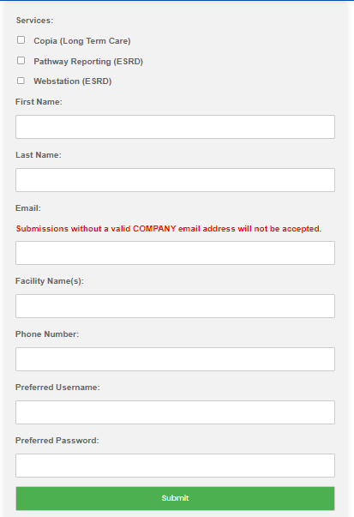
Platform Access
Requests Available Online
Meridian Ordering
Place test orders.
Review individual patient results.
Pathway Reporting Tool
Reporting Tool
Review results for multiple patients.

Slide 39
Questions

Slide 40
Meridian Laboratory Corporation

